Slide 1


Predicting Heterogenous Human Activity using Smartphone Senor Data
Project by - Sushrutha Dhummi Thrilochana ( MM73053 )
Under Guidance - Prof. Christopher McGraw

Slide 2
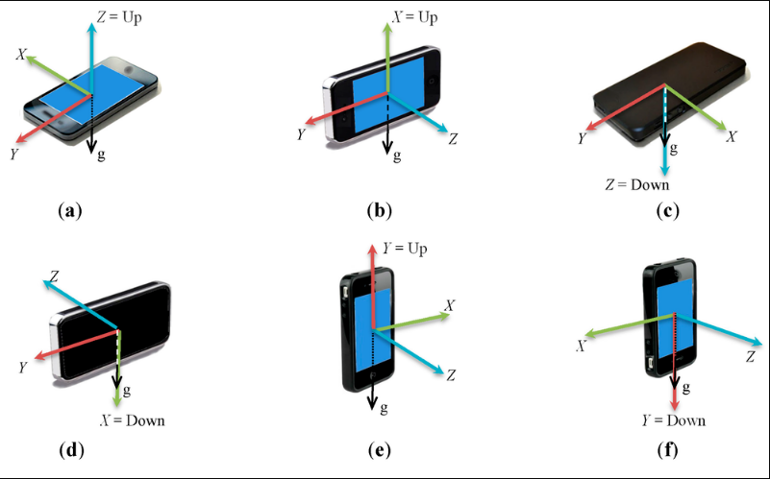
Project Abstract
Human Activity Recognition database built from the recordings of 30 subjects performing activities of daily living (ADL) while carrying a waist-mounted smartphone with embedded inertial sensors.

Slide 3
Data Description
The features selected for this database come from the accelerometer and gyroscope 3-axial raw signals tAcc-XYZ and tGyro-XYZ. These time domain signals (prefix 't' to denote time) were captured at a constant rate of 50 Hz. Similarly, the acceleration signal was then separated into body and gravity acceleration signals (tBodyAcc-XYZ and tGravityAcc-XYZ) . Subsequently, the body linear acceleration and angular velocity were derived in time to obtain Jerk signals (tBodyAccJerk-XYZ and tBodyGyroJerk-XYZ). Also, the magnitude of these three-dimensional signals were calculated using the Euclidean norm (tBodyAccMag, tGravityAccMag, tBodyAccJerkMag, tBodyGyroMag, tBodyGyroJerkMag). These signals were used to estimate variables of the feature vector for each pattern: '-XYZ' is used to denote 3-axial signals in the X, Y and Z directions.
Additional vectors obtained by averaging the signals in a signal window sample. These are used on the angle() variable:
gravityMean
tBodyAccMean
tBodyAccJerkMean
tBodyGyroMean
tBodyGyroJerkMean

Slide 4
Problem Statement
In today's world, many people die as a result of disease outbreaks and bad lifestyles. People have become more conscious of their lifestyle choices and are attempting to improve their fitness. As a result, any digital companion that supports human fitness, such as recording calories burned, sleep cycle, and other records, is an added benefit. As an athlete, I believe it is critical to keep track of all of these factors in order to live a healthy lifestyle.

Slide 5

Motivation
When I was 21, I got my first Fitbit watch, and I was constantly curious about the amazing function that had been released. Activity tracking was one of the features. When the same feature was released in Apple and later Android devices, I was perplexed. This kept me on my toes, and I learned that the data came from the sensors, but I had no idea what types of sensors there were or what the underlying mechanism was. I was taught all of the necessary topics to develop the same underlying technology that I fantasized about throughout my late childhood thanks to Prof. Christopher McGraw's course.

Slide 6
Objectives
To use classification models to classify multinomial variables that is 6 degrees
Use of dimension reduction techniques on models

Slide 7
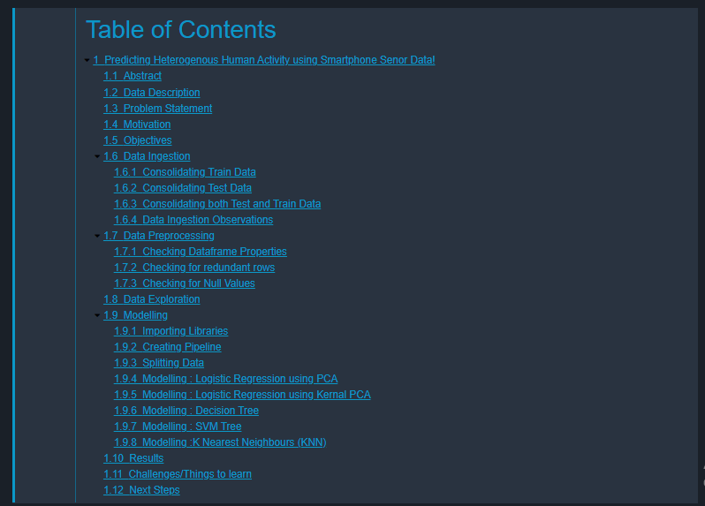
Table of Contents of Notebook

Slide 8
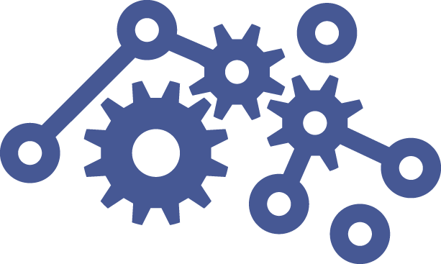




Methodology
5
4
3
2
1
Dataset Preparation
Data Preparation
Exploratory Data Analysis
Modeling
Interpret Results
Data Ingestion from different files
Data Merging, Data Cleanup, Feature Engineering, Scaling and Encoding
Model Training, Parameter Tuning, Model Tuning, Model Validation
Model Evaluation, Communicate Results
Visualizations and Insights, Descriptive Analysis,

Slide 9
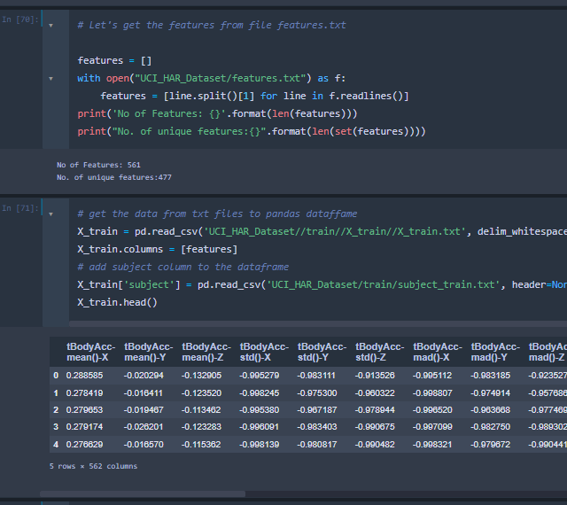
Data Ingestion
Merged Train Data
Merged Test Data
Merged to common Data frame

Slide 10
Data Preprocessing
Merge Data
Null Value Checks
Duplicate Checks
Data Type Checks
Correlation Checks
Outlier Checks
Sanity Check on merged Data
No Null Values found
No duplicated found
No Data Type conversions
No significant correlation > 1
No Domain Knowledge to judge outliers

Slide 11
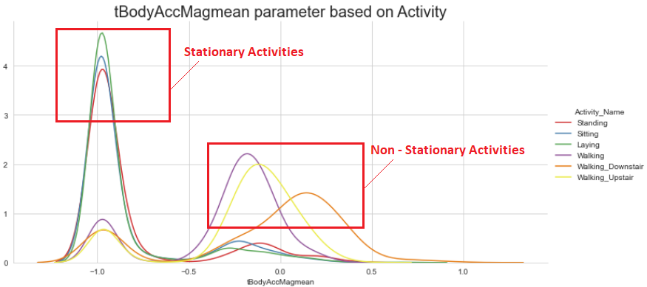
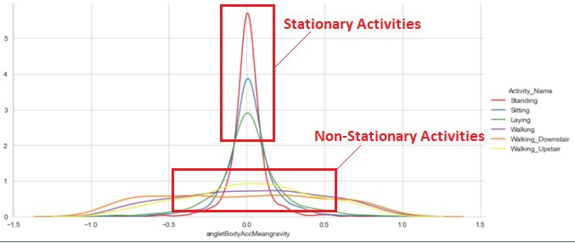
Exploratory Data Analysis
The Left gaussian peaks shows stationary Activities , where the Body accelerometer value is more; Vice Versa.
The Right Gaussian peaks shows Non-Statinary Activities, here the Body accelerometer value is less and Vice Versa.
High peaks of gaussian curve is of Stationary activities of Body gravity acceleration values
Low Peaks are of Non-Stationary Actvity of Body gravity acceleration values.

Slide 12
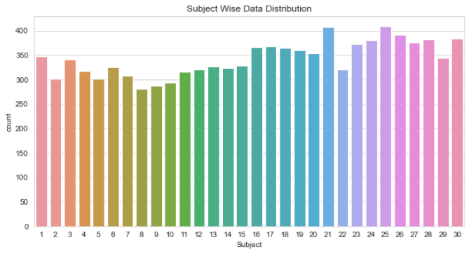
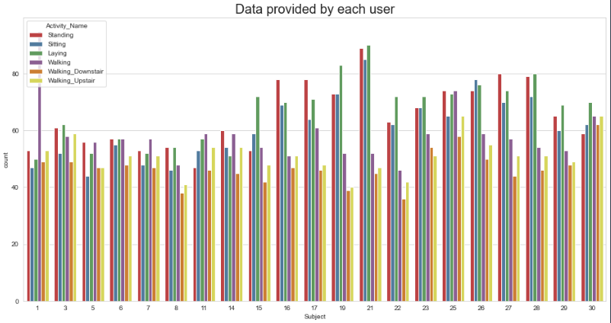
- Subject '21' has provided most data w.r.t to Standing/Sitting/Laying. (probably works a Desk Job)
- Subject '1' Walked a lot! ( Walks to work ? )
- Subject '25','30' Climbed stairs the most ( were on a diet ? )

Slide 13
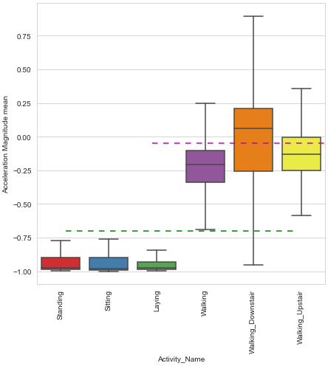
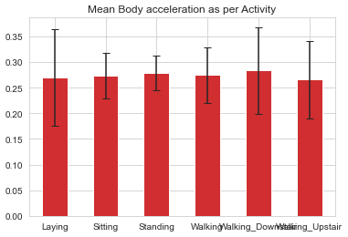
Standing, Sitting, or Laying are the Activities if tAccMean is -0.8.
Walking, WalkingDownstairs, or WalkingUpstairs are the Activities if tAccMean is > -0.6.
The Activity WalkingDownstairs is defined as tAccMean > 0.0.

Slide 14
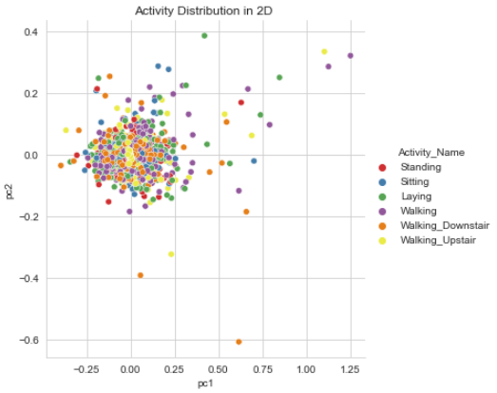
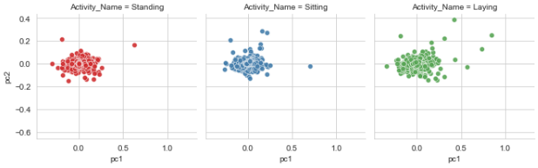
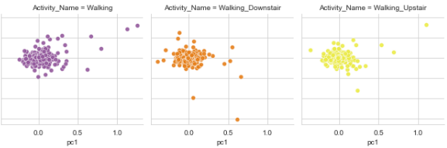
Visualizing multidimensional data by mapping each observation

Slide 15
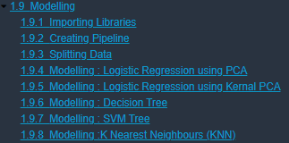
Modelling
Classification Models
Logistic Regression
Naïve Bayes
K Nearest Neighbor
SVM
Decision Tree

Slide 16
Modelling Accuracy
Model Name | Accuracy
Logistic Regression Score | 98%
Decision Tree | 94%
Support Vector Machine | 98%
K-Nearest Neighbour | 97%

Slide 17
Dimensionality reduction methods
Linear Method
PCA
Non-Linear Method
Kernel PCA
Kernel PCA

Slide 18

Challenges
I chose a dataset with an excessive number of rows because it was ambitious.
This was an advanced multinomial classification challenge, since I spent a significant amount of time overcoming issues such as
Multiclass format issues.
Multi Index and Sigle-index related Issues.
Problems with Multiple-Label Indicators
Value Errors, such as Not Enough Values to Unpack - Problems with Multiclass AUC Curves
Tuning the model to resolve overfitting proved tricky for me.

Slide 19
Next Steps
Use of grid search have improved the score by few pointers.
Since there are 500+ columns models are bit overfit, as the AUC score is around 97 to 99 . I could adopt below technique to prevent overfitting
Cross validation techniques – k folds
Ensemble Techniques - Bagging, Boosting

Slide 20
References
Human-Activity-Recognition-with-Smartphones/Human_Activity_Recogn_EDA.ipynb at master · sushantdhumak/Human-Activity-Recognition-with-Smartphones (github.com)
https://scikit-learn.org/stable/modules/generated/sklearn.decomposition.PCA.html
Lecture Slides
https://jupyter-contrib-nbextensions.readthedocs.io/en/latest/nbextensions/codefolding/readme.html
https://pandas.pydata.org/pandas-docs/version/0.25.0/reference/api/pandas.DataFrame.to_csv.html
https://towardsdatascience.com/handling-overfitting-in-deep-learning-models-c760ee047c6e

